Slide 1
Unsupervised Algorithms in Machine Learning
DTSA 5510 Final Project

Slide 2
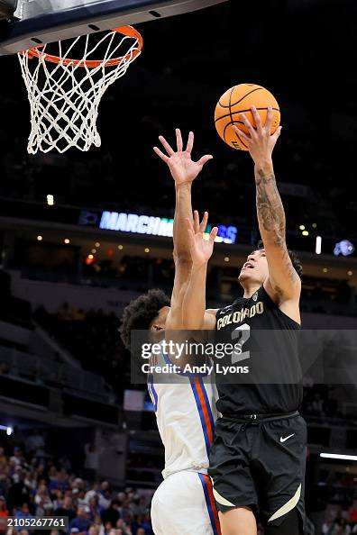
Table of Contents
Motivation
Data
Cleaning / EDA
Preprocessing
Modeling
Discussion
Conclusion
Image: Getty Images

Slide 3
Motivation
The NCAA March Madness Tournament selects 68 teams to play every year
Currently a group of ‘experts’ called the Selection Committee selects the non-automatic qualifying teams, and groups them into seeds 1 - 16
Can we eliminate human bias from this process by developing unsupervised machine learning algorithms to group and seed these teams for us?

Slide 4
Data
The data comes from the Kaggle competition: March Machine Learning Mania 2025
This project is unrelated to the Kaggle competition
Kaggle provides 36 csv files for the completion but I only used the following:
Mteams.csv
MNCAATourneySeeds.csv
MRegularSeasonDetailedResults.csv
MTeamConferences.csv (decided against using)
After cleaning, transforming and engineering features, the final feature set for modeling includes 54 float variables

Slide 5
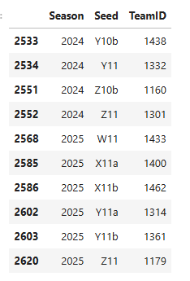
Cleaning / Transforming
Kaggle data fairly clean to begin with
Initial cleaning required removing characters from seeds in the csv containing tournament seeds
No missing data or imputation required
Extensive work done to get data into a state for modeling
Merge columns for winning and losing teams
Merge columns for home and away games

Slide 6
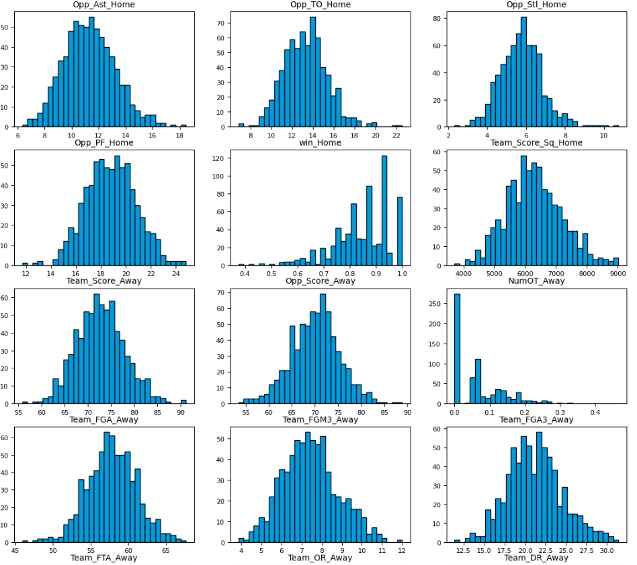
EDA
Data Distribution
Reviewed histograms for all float columns to look for any issues
Relatively expected distributions, but some concerns about the scale of different variables
Noticed some odd gaps but no worrying outliers

Slide 7
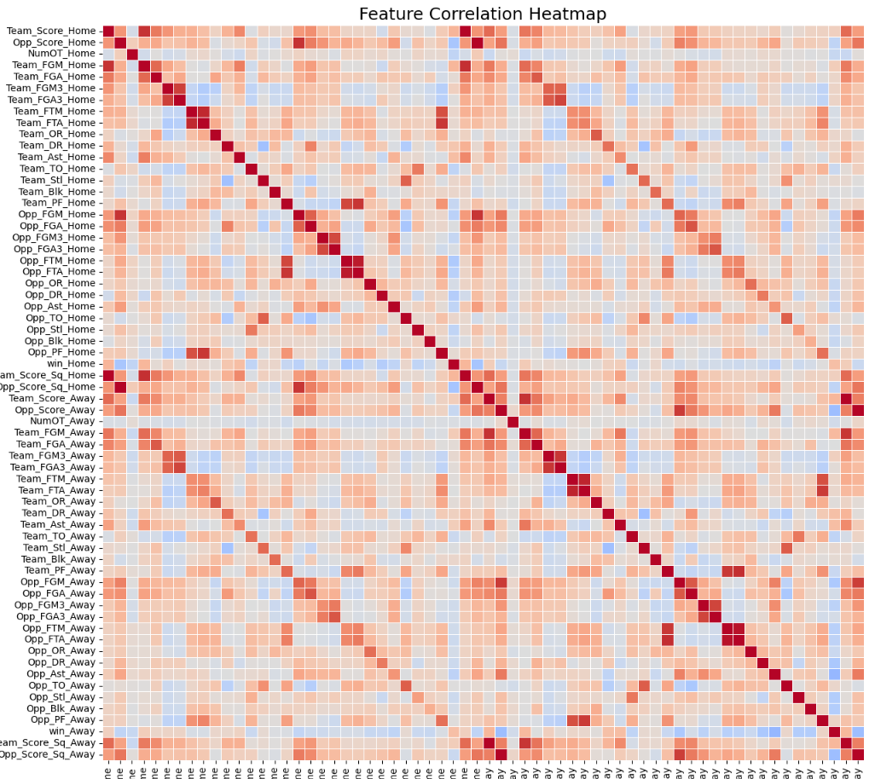
EDA
Correlation
Generated a pair plot to investigate correlation
Problem areas with scores and all types of field goals attempted
Problem area with free throws and personal fouls
Concern about home-away splits
Removed any features with correlation above 0.80

Slide 8
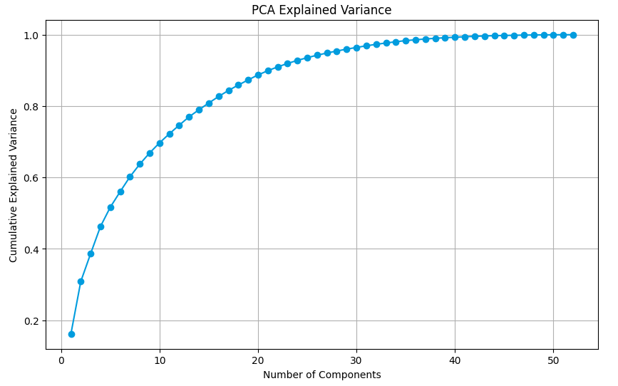
Preprocessing
Preprocessing to help reduce dimensionality
After removing highly correlated variables, still have 54 features!
Used the decomposition technique of PCA to reduce features even further
Evaluated Cumulative Explained Variance Plot to decide on a feature space of 10 eigenvectors representing the most variance in the data

Slide 9
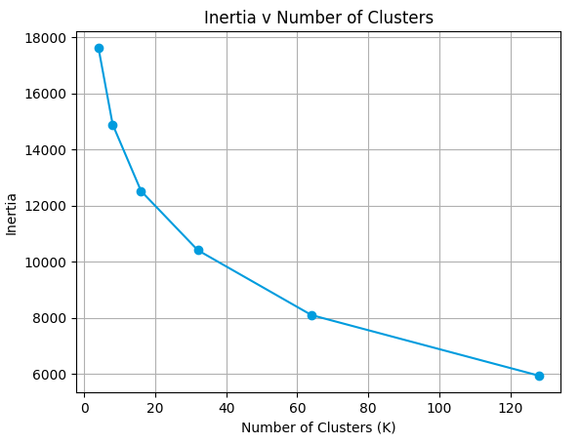
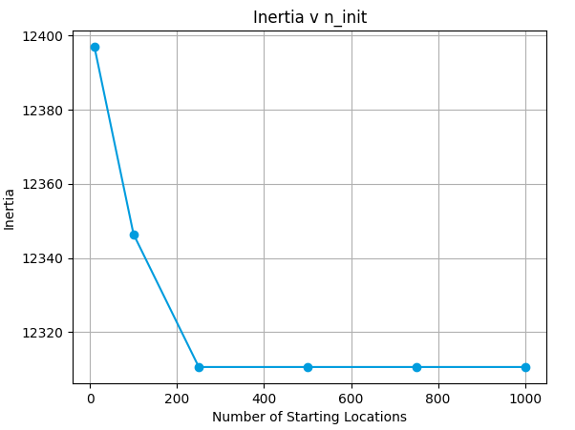
Modeling
Two primary approaches used for clustering into potential seeds
Kmeans and Agglomerative/Hierarchical
Kmeans
For kmeans I experimented with different cluster sizes and number of initial configurations to try and reduce model inertia (sum of squares within cluster)

Slide 10
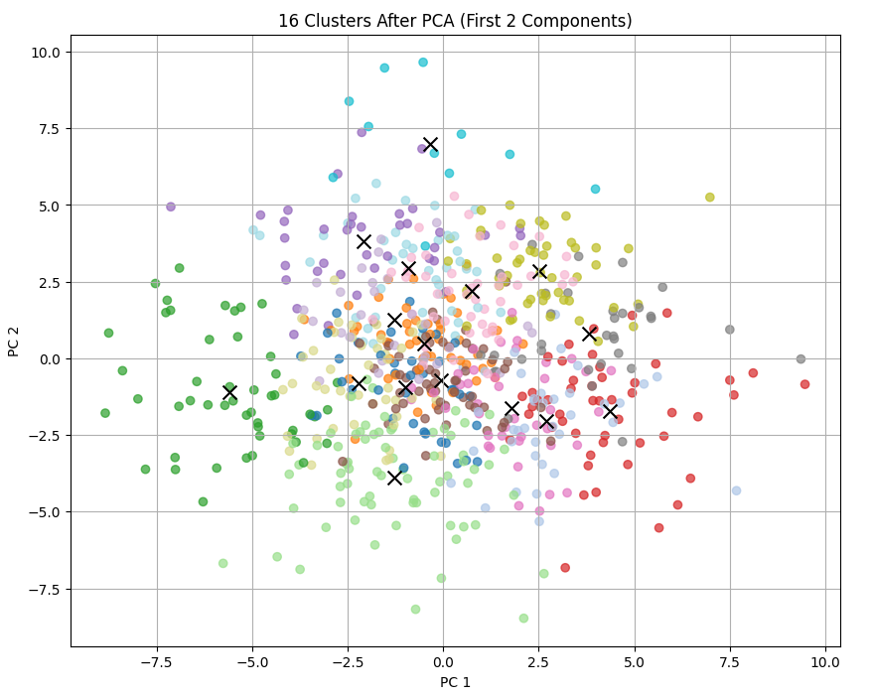
Modeling (kmeans)

Slide 11
Modeling (hierarchical)
For hierarchical cluster I tuned hyperparameters via their distance measure and linkage
First model used cosine distance measure and complete linkage
Second model used ward distance
Euclidean distance and linkage determined by least variance within groups

Slide 12
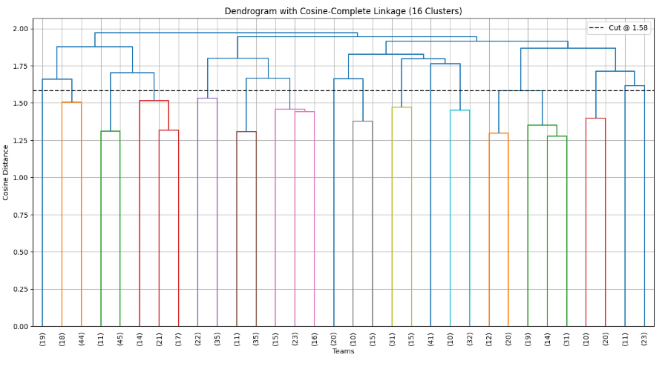
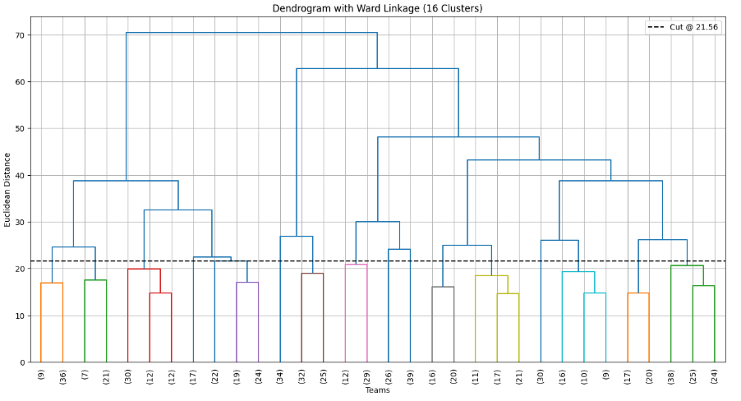
Modeling (hierarchical)
Cosine-Complete
Ward

Slide 13
Discussion
Results
Results were a bit hard to interpret. Idea wasn’t to check or predict seeds, but to see if we could do seeding in a better way
Too many teams in a cluster
Clusters weren’t ordered so that needed to be done manually
Compared the results to actual seeds for 2025 season
Cosine-Complete Hierarchical method produced the best results
Further Work
Lots of additional data could be modeled
Get better at measuring strength of schedule and opponent performance
Different algorithms like DBScan

Slide 14
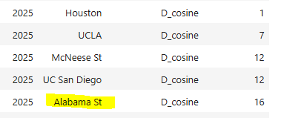
Conclusion
Encouraging Results
The modeling didn’t come out as well as I hoped but I think there’s promise with this approach
Surprising findings
Alabama State
Texas A&M
I believe we’ve shown that school and conference bias plays a role in Selection Committee decisions
Need to find a better way to quantify my findings

